Slide 1
Workshop CityGML WP9 – Other Constructions
Joachim Benner, KIT

Slide 2
Central issues
Consistent ontology for CityGML feature types
Which real world objects are associated with which existing feature type?
Are there real world objects which are not covered by any existing (or planned) feature type
Is the naming of the existing feature types adequate?
Data model for OtherConstruction
Definition
Naming
Geometric properties
Non-geometric attributes
Semantic structuring (if any)

Slide 3
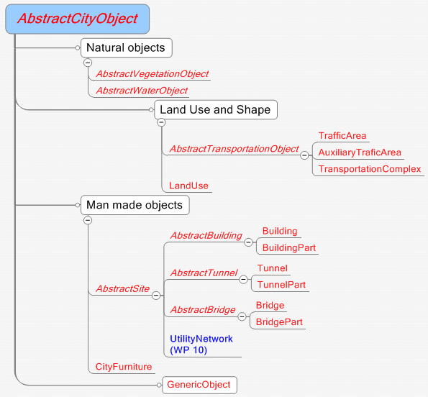

Slide 4
Building – SIG3D definition
A free-standing, self-supporting construction that is roofed, usually walled, and can be entered by humans and is normally designed to stand permanently in one place. It is intended for human occupancy (for example: a place of work or recreation), habitation and/or shelter of humans, animals or things

Slide 5
Bridge – SIG3D definition
Civil engineering works that affords passage to pedestrians, animals, vehicles, and service(s) above obstacles or between two points at a height above ground (cf. ISO 6707-1)

Slide 6
Tunnel – SIG3D definition
Horizontal or sloping enclosed passage way of some length, mainly underground or underwater (cf. ISO 6707-1).

Slide 7
Transportation – SIG3D definitions
Traffic Area - Space of movement for either trains, vehicles or pedestrians
AuxiliaryTrafficArea - Space within the transport area not intended for traffic purposes
TransportationComplex - Aggregation of TrafficAreas and AuxiliaryTrafficAreas, e.g the different lanes of a multi-lane road.
Remark:
Not covered are, e.g., water traffic, airports, and any kind of infrastructure objects related to traffic

Slide 8
CityFurniture – Description in CityGML 2.0 spec.
City furniture objects are immovable objects like lanterns, traffic lights, traffic signs, flower buckets, advertising columns, benches, delimitation stakes, or bus stops (Fig. 67, Fig. 68). City furniture objects can be found in traffic areas, residential areas, on squares or in built-up areas. The modelling of city furniture objects is used for visualisation of, for example city traffic, but also for analysing local structural conditions. The recognition of special locations in a city model is improved by the use of these detailed city furniture objects, and the city model itself becomes more alive and animated.

Slide 9
CityFurniture - Examples

Slide 10
Utility Networks
This new thematic area will be developed in WP10
Actually, only a two years old, preliminary version of a CityGML 2.0 ADE is known
Especially, is not clear whether the Utility Networks module also handles infrastructure objects like masts, tanks, shafts, …

Slide 11
Summary
The CityGML ontology is not very consistent, strict and complete, especially in the area of technical infrastructure
There are some specific thematic areas for technical infrastructure, but there exist a lot of thematic areas not covered by CityGML 2.0
Protection against natural hazards (dams, walls, …)
Water infrastructure (barriers, locks, …)
Traffic infrastructure (terminals, gantry cranes, …)
Industrial facilities
Monuments
…
The concept of CityFurniture is not exactly defined, but illustrated by examples and use-cases

Slide 12
What can be done?
Definition of one (or more) additional CityGML feature type(s) to cover the missing real world objects
This makes the poor ontological structure of CityGML even worse
Revision of the complete CityGML structure to define a better ontology
Actually, there is no corresponding change request
Very difficult to perform within the organization structure of 14 independent working groups

Slide 13
Proposal KIT
Renaming AbstractSite → AbstractTechnicalObject
New properties for AbstractTechnicalObject:
Condition of Construction
Dates (Construction, last Renovation, Demolition)
Elevation
Height
Geometric representation in LoD0 – LoD3 (??)
Elimination of class CityFurniture
New class OtherTechnicalObject, derived from AbstractTechnicalObject, including City Furniture

Slide 16
Questions
Is the differentiation of „intended function“ (attribute function) and „current usage“ really needed?
Percentage of usage as optional attribute?
Codelists?
For LoD0 representation:
2D representation?
Point / Line / MultiSurface representation
For LoD1 representation
MultiSurface representation needed?
For all representations
Additional metadata
Move representations to super class?

Slide 17
ISPIRE Building

